Slide 1
A Brief Introduction to Tableau
Richard Johansen

Slide 2
Workshop Agenda
What is Tableau?
Understanding Data
Data Visualizations
Work in Tableau Desktop (Public)

Slide 3

What is Tableau?
R is a programming language specifically designed for statistical analysis and graphics
R is free & open-source used in many academic and industry disciplines
R Studio is the Interactive User Interface compatible with R
R and R Studio can be downloaded here:
http://cran.r-project.org/
https://www.rstudio.com/products/RStudio/#Desktop

Slide 4
Why Use Tableau?
Pros:
Reproducibility
Explicit documentation of steps
Versatile
Run on any operating system
Integrates with other software, languages, and data extensions
Python, Java, SAS, SPSS, Excel
Free and Open-Source w/ large active community
10K+ packages CRAN, Twitter, GitHub, etc.
Comprehensive
Eliminates the need for multiple software
GIS, Excel, ENVI, etc.
Computationally Robust
Fast and allows for high level analysis
Cons:
Steep Learning Curve
Requires a significant time investment especially starting with little to no coding experience
Limited “Point & Click”
R Commander or Radiant?
Open-Source
Rely on creators to follow coding etiquette
Version control and instability

Slide 5
What is Data?
Data is a collection of objects defined by attributes
An attribute is a property or characteristic of an object
Examples: eye color of a person, temperature, etc.
Synonyms: Columns, variables, fields, characteristics, features, etc.
An object is the phenomena being described or evaluated
Examples: Bob/Sarah, house, substance, etc.
Synonyms: Rows, records, points, cases, samples, instances, etc.

Slide 6
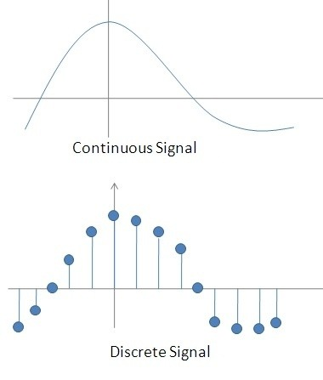
Attribute Classification
Discrete Attribute – has a countable set of values
Examples: zip codes, number of words,
Typically represented as integers
Continuous Attribute - has an infinite set of numbers and potential divisions
Example: temperature, height, weight
Typically represented as floating point (decimal)
https://qph.fs.quoracdn.net/main-qimg-7badb966d5ff6063ddb515737011ed1b-c

Slide 7
Important Attribute Classes
Categorical
Nominal - Data that can be counted, but not aggregated or ordered
Examples: Eye Color, Zip Code, Music Genre
Ordinal - Data that can be counted and ordered, but not aggregated.
Examples: Grades, Clothing Size, Positions (in a race)
Numerical
Interval (metrics) - The difference in values are constant and meaningful
Examples: The difference between a temperature of 100°F and 90°F is the same difference as between 90°F and 80°F.
Ratio - An interval scale with an absolute zero
Examples: Income, Height, Weight

Slide 8
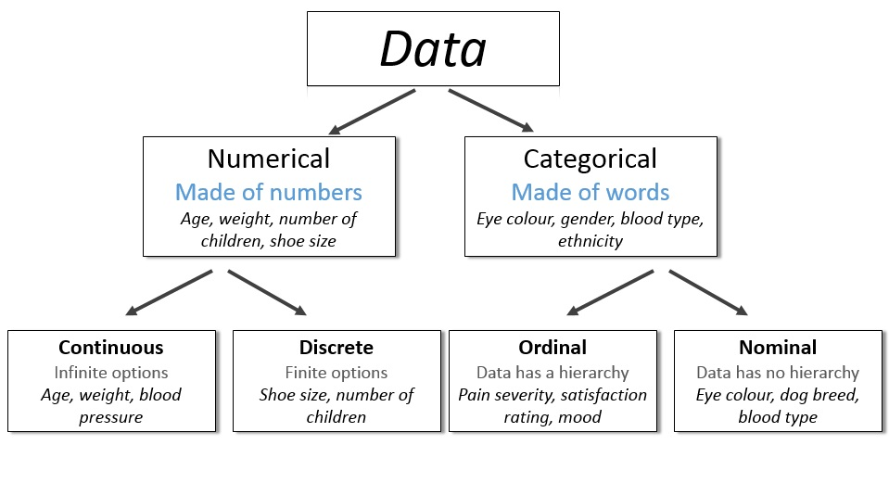
http://survivestatistics.com/variables/

Slide 9
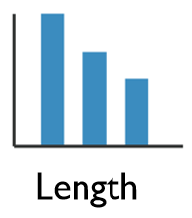
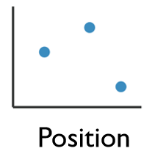
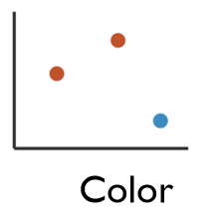
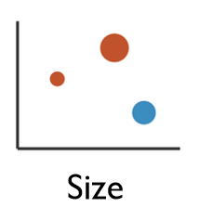
Enhancing Visualizations
1 Dimensional Data
Length
2 Dimensional Data
Position
2+ Dimensional Data
Position
Color Hue/Saturation
Size
Shape

Slide 10
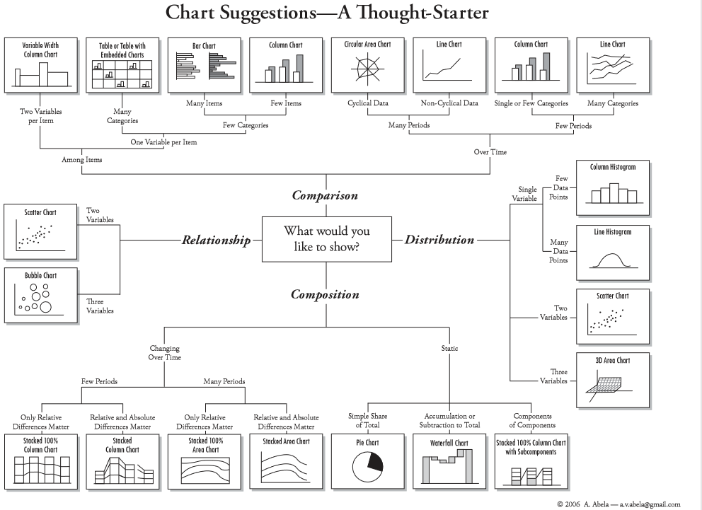
Four Basic Chart Types
http://extremepresentation.typepad.com/files/choosing-a-good-chart-09.pdf

Slide 11
Want to continue learning Tableau?
Academic Courses:
CS 2005C – Introduction to Programming for Informatics with Python and R
BE 8083 – Data Analysis with R and SAS
BANA 5143 – Statistical Computing
PH 7011 – Statistical Computation and Software
Lynda (Free Online courses):
Learning R
Data Wrangling with R
R Statistics Essential Training
Library Workshops:
https://webapps2.uc.edu/ce/facdev/Workshops

Slide 12
Contact Research & Data Services West
Email: AskData@uc.edu
Web: https://libraries.uc.edu/digital-scholarship/data-services.html
GitHub: https://github.com/RAJohansen/
Visit: 240 Braunstein Hall (Geology-Math-Physics Library)
Consultations: walk-ins during open consultation hours or appointment by email
Twitter: @DataVizJohansen

